Slide 1
Limitless Data Estate
13 – Aug – 2019
By Jahnavi

Slide 2
Agenda
Executive Summary - Setting the Context
Data -> Data Estate
The Exponential Growth of Data - Cause
Enormous Growth in Data - Challenges
Prepare and Prosper
Q & A

Slide 3
Executive Summary
Setting the Context – Limitless Data Estate
World is changing, Data is becoming key input to businesses
The amount of Digital Data in the universe is growing at an exponential rate
The Rise of Real-Time Data - Prepare for Exponential Growth

Slide 4
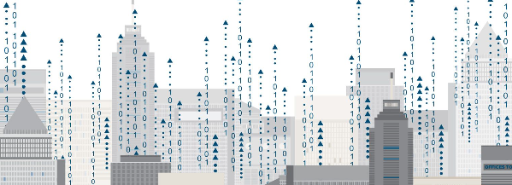
Data -> Data Estate
Infrastructure
Storage / Capacity & Manage
Analytics
What is Data
Information
Binary Digital Form
Processing
Data Estate
Notes:
Data
Information that has been translated into a form that is efficient for movement or processing
Data is information converted into binary digital form
Computer data is processed by the CPU and is stored in files and folders and the computers hard disk
A data estate is simply the infrastructure to help companies systematically manage all of their corporate data
Organizations can store, manage and leverage their analytics data, business applications, social data, customer relationship systems, functional business and departmental data, Internet of things and more
You need amazing capacity from an operational store perspective

Slide 5
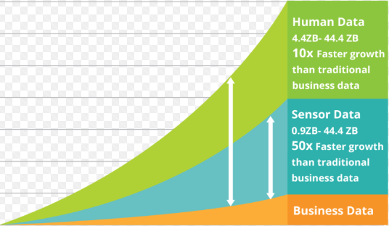
The Exponential Growth of Data
Exceeding the capacity of traditional computing
Faster growth rate than traditional business data
90 % of the data created in the last two years
Petabytes of real time data
Latest range of data - Zettabytes
Cont’d
Notes:
Growth of data is exceeding the capacity of traditional computing
Human and machine generated data is experiencing an overall 10X faster growth rate than traditional business data, and machine data is increasing even more rapidly at 50X the growth rate
90 % of the data that we have today was created in the last two years
Petabytes of real time data is moved for analytical pipeline
Latest range to measure the data is now covering a space of 21 orders of magnitude

Slide 6
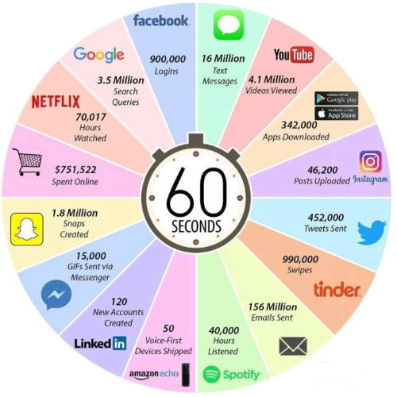
Key Trends Causing Data Explosion
Cont’d
Consumers interaction with varied devices / sources
Internet
Social Media
Communication
Digital Photos
Services
Internet of Things
We’ll all benefits from these advances in so many ways – Social Benefits
Notes:
In the early days of the digital revolution, data was produced mainly from PC’s. But moving ahead the new growth will be coming from varied sources. Today, more than 5billion consumers interact with data every day. Many of these interactions are because of billions of IoT devices connected across the globe
We conduct more than half of our web searches fro a mobile phone now
Social Media certainly fuels data creation via Linkedin, Youtube, Twitter, Instagram, Facebook, etc
Sending texts, e-mails and calls via skype
Now that our smart phones are exemplary cameras as well, everyone is a photog and the trillions of photos stored is the proof
Request to weather channels, cab drivers, wikipedia are some of the services
The Internet of Things, connected smart devices that interact with each other and us while collecting all kinds of data, is exploding
Social benefits like real time fraud detection, efficient traffic flow management between smart vehicles and prioritized traffic protocols for emergency response vehicles and facial recognition for improved security at sporting events or transportation hubs
This is what happens in an internet minute

Slide 7
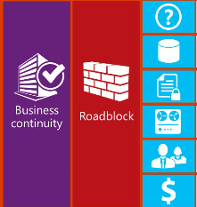
Data Growth Challenges
System Management
Data center Power
Storage
Lack of Support
Shortage of Skills
Notes:
The exploding volume and speed of data growth has introduced several challenges
System management and growing cluster complexity
Data center power, cooling and floor space limitations
Storage, data movement and management complexity
Lack of support for heterogeneous environment and accelerators
Significant shortage of skills to integrate and manage the super data ecosystem
Impact of data growth on business continuity and few other challenges are depicted here – like data security, disaster recovery, higher costs for the increased data size

Slide 8
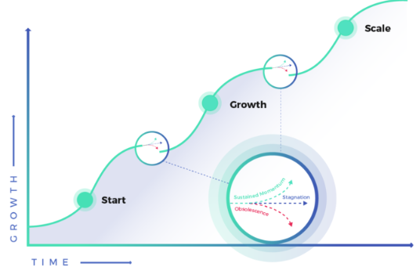
Business must be equipped to manage Data Growth
Operational cost of data infrastructure
Elasticity and flexible capacity
Performance of work loads
Scale of Infrastructure
Notes:
Business leaders can prosper by embracing new and unique business opportunities powered by this wealth of data and the insight it provides. It is important to understand how to identify and leverage the specific data that will deliver the most value for business
Some of the focus areas would be
Manage growth and operational cost of infrastructure
Provide elasticity and flexible capacity
Ensure performance for diverse workloads
Rapidly deploy and scale infrastructure
Here the S curve where a business must make a fundamental shift for the forward momentum

Slide 9
Q &A
Thank You

